Slide 1
American Education Week

Slide 2
INTRODUCING MYSELF…
Name and Title
Include information about yourself here…
(consider sharing a personable, relatable story of what makes you memorable. For example: a detailed story of a time where you helped a patient during a difficult moment like feeling nervous or anxious during the eye exam. Or styling a child patient in eyewear they loved even though when they found out they needed eyeglasses they were distraught. The child left happy because now they can see and "be seen" with gorgeous glasses that suits them.)

Slide 3
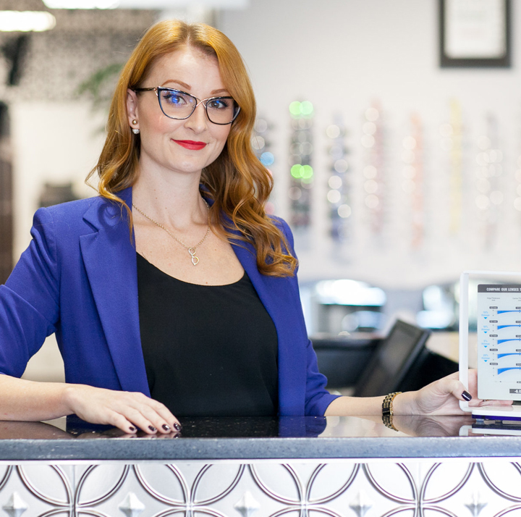
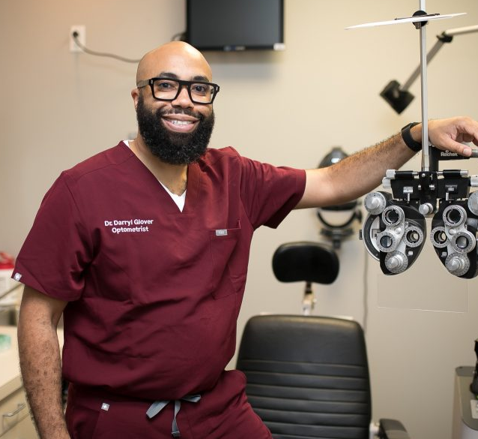
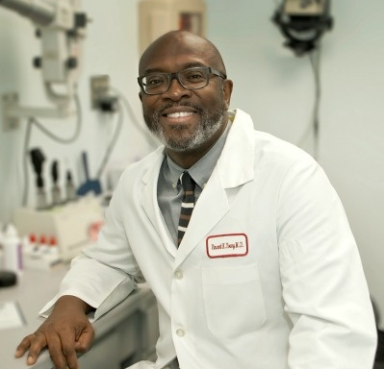
THE THREE O’S OF EYES
Meeting host to have an arrow point to which one they are
Optician
An eyecare professional who designs and fits eyewear based on the optometrist’s eye exam and prescription.
Optometrist
Primary eye care doctors who examine, diagnose, and treat patients' eyes.
Ophthalmologist
Eye doctors who perform medical and surgical treatments for eye conditions.

Slide 4
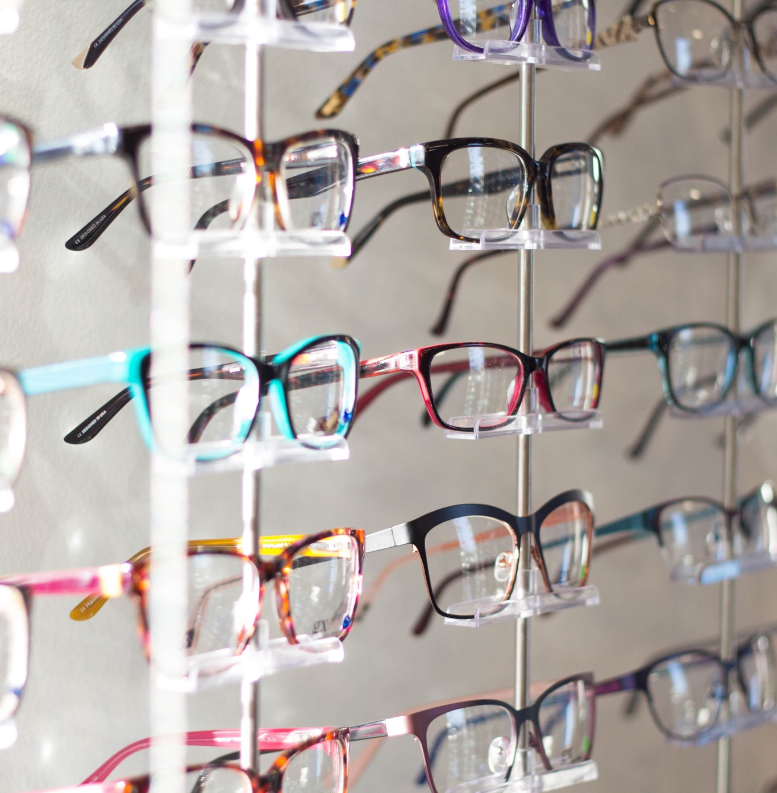
MY JOB AS AN OPTICIAN
Use the slide that applies to your profession and hide the others.
Opticians are technicians trained to fit eyeglass lenses and frames, and contact lenses to correct vision problems.
We help you see clearly and look good!
A career as an optician requires 0-4 years of schooling.

Slide 5
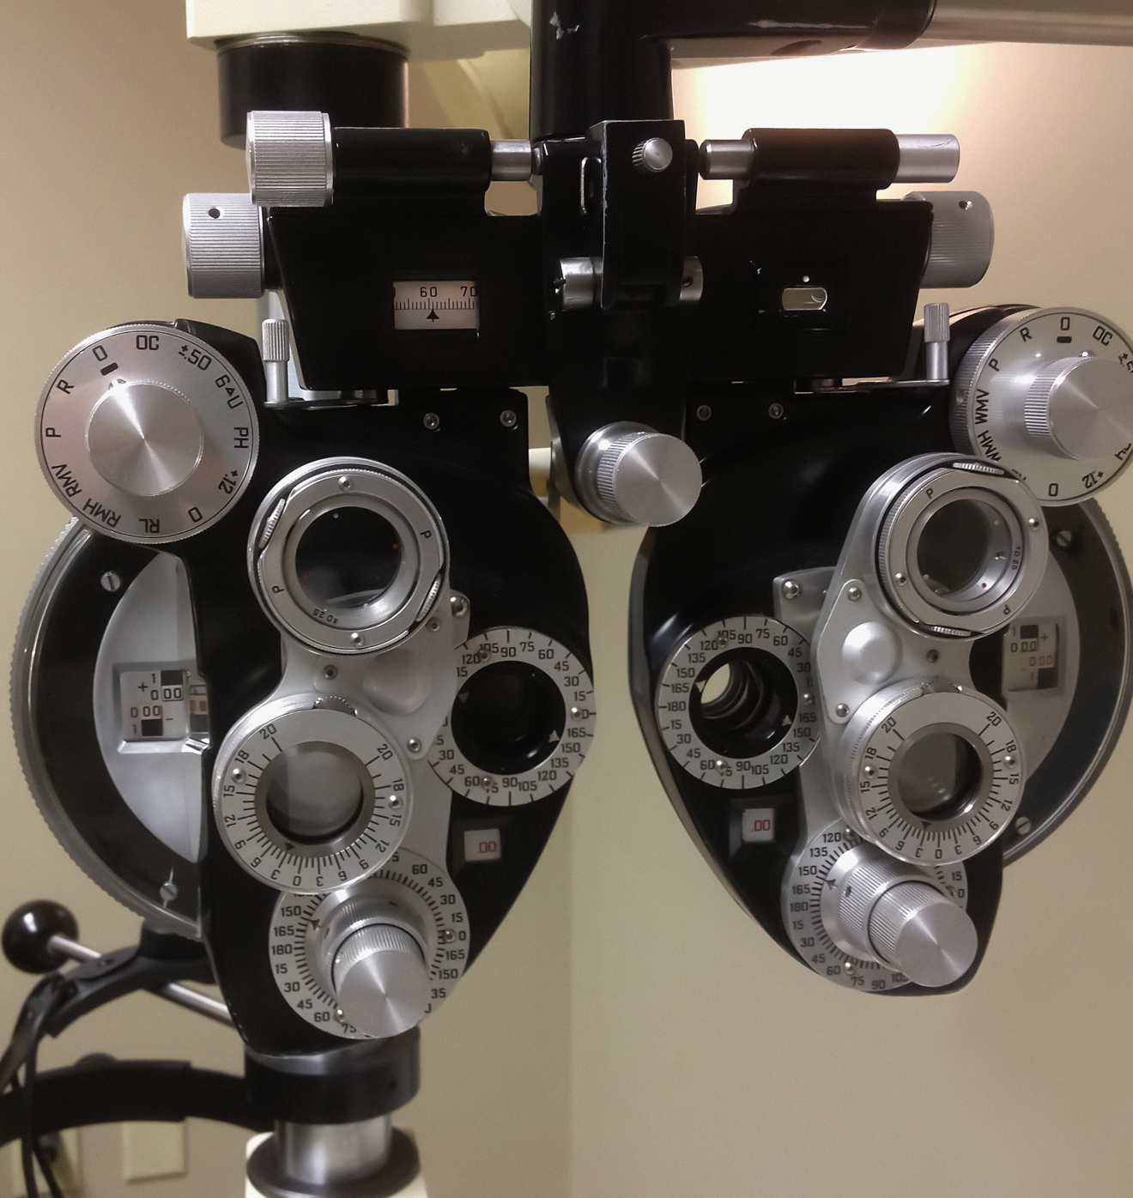
MY JOB AS AN OPTOMETRIST
Use the slide that applies to your profession and hide the others.
Optometrists provide vision care. They diagnose and treat vision problems and eye diseases. Optometrists prescribe eyeglasses, contact lenses and vision therapy. They help care for patients after some types of eye surgery. Optometrists usually work with people of all ages. Some may specialize in groups, such as children.
A career as an optometrist requires 8 years of schooling.
Notes:
Classes to take in school are English, mathematics, physics, chemistry, biology. psychology, history, sociology, speech and business.

Slide 6
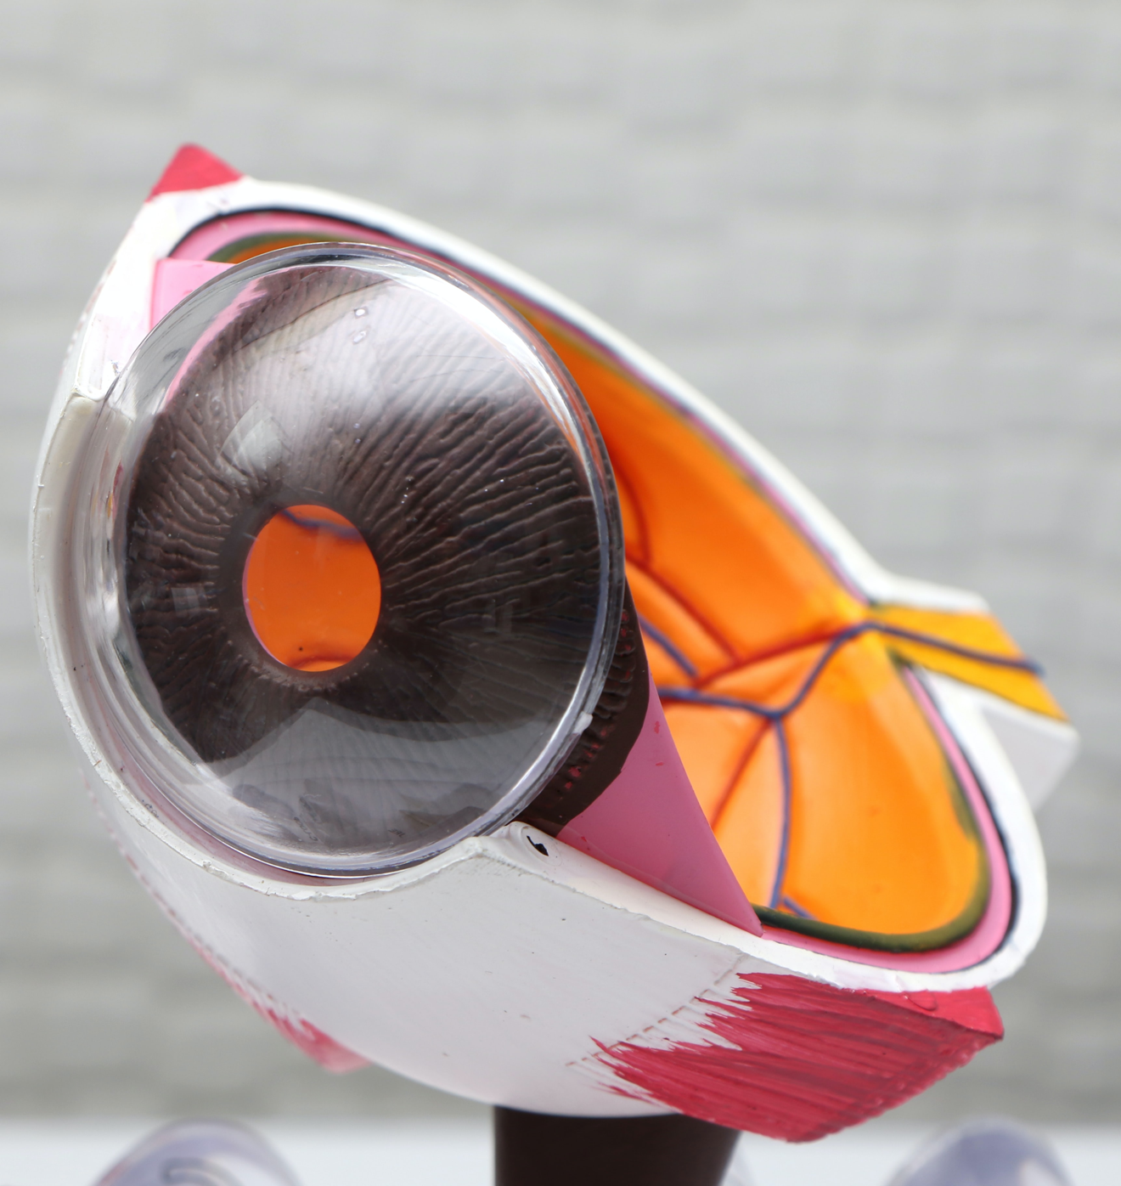
MY JOB AS AN OPTHALMOLOGIST
Use the slide that applies to your profession and hide the others.
Diagnoses and treats all eye diseases, performs eye surgery and prescribes and fits eyeglasses and contact lenses to correct vision problems.
12 years of Schooling

Slide 7
A TYPICAL DAY IN MY LIFE…
(consider adding another personal story here!)

Slide 8
MY FAVORITE ASPECT ABOUT MY JOB…
(consider adding another personal story here!)

Slide 9



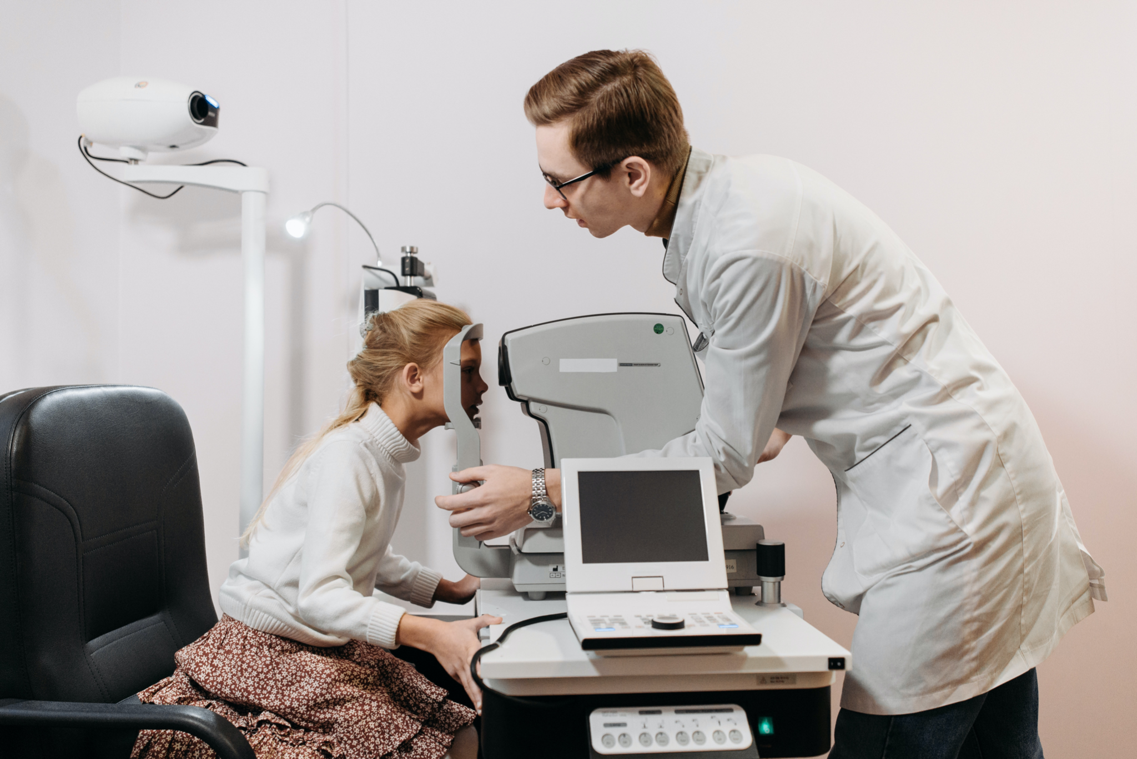
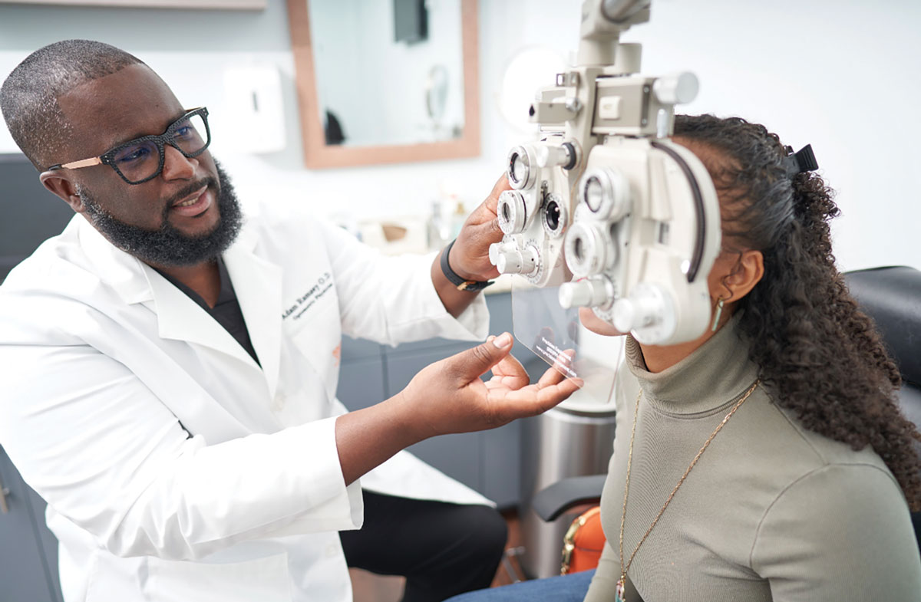

SKILLS NEEDED TO BE A SUCCESSFUL EYECARE PROFESSIONAL
Strong communication and listening skills
Enjoy collaborative work
Organized
Ability to make people feel comfortable
Interested in health & desire to improve people's quality of life.
Ability to practice patience

Slide 10

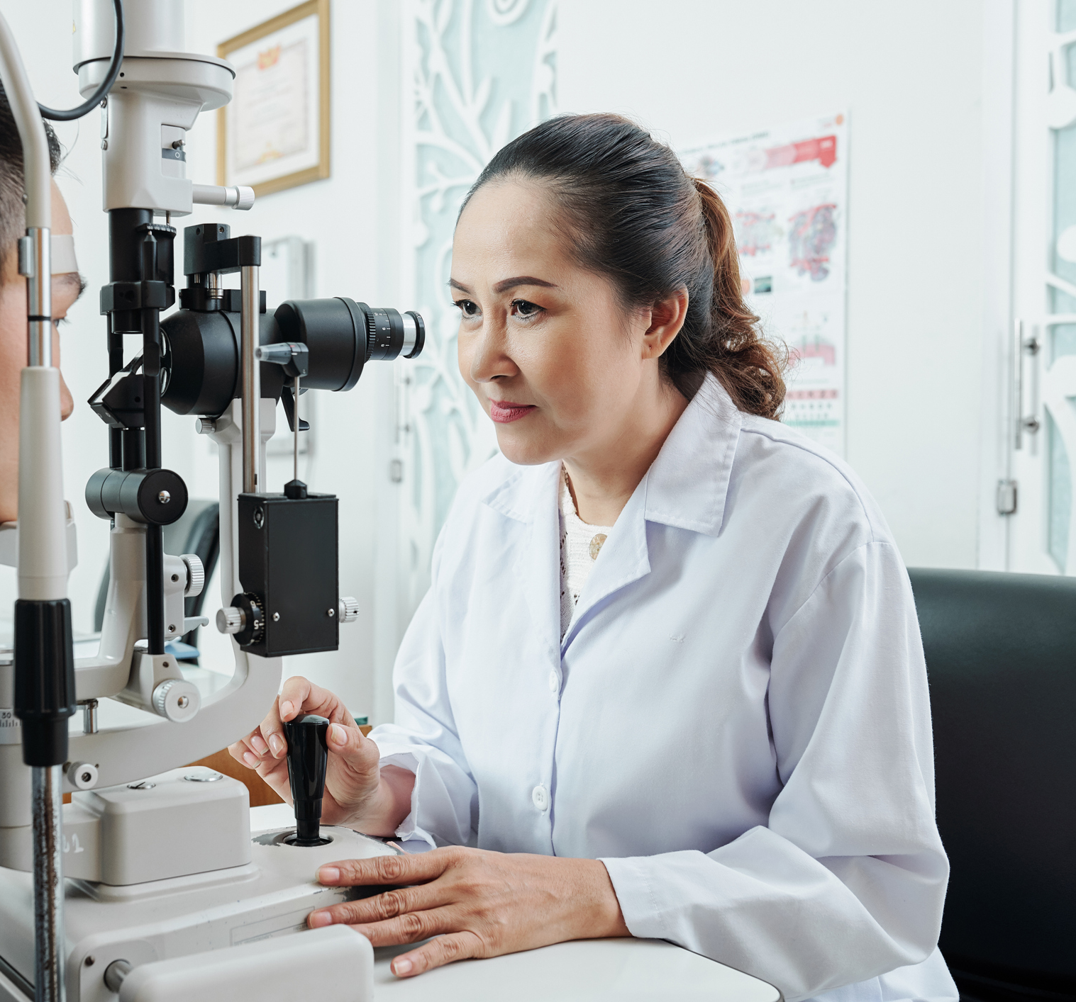


THE NEED FOR DIVERSITY WITHIN OPTICAL CAREERS
↘ Under-representation
↘ Under-representation
50.52% US POP IS
FEMALE
43% Optometrist
67% Optometry School
73% Optician
7% US POP IS
ASIAN
22% Optometrist
28% Optometry School
5% Optician
18.7% US POP IS HISPANIC
4.7% Optometrist
5.5% Optometry School
3.11% Optician
13.6% US POP IS
BLACK
1.8% Optometrist
2.7% Optometry School
3.7% Optician
https://www.census.gov/library/stories/2021/08/improved-race-ethnicity-measures-reveal-united-states-population-much-more-multiracial.html
(2018) Optometry and Opticianry Stats: https://datausa.io/profile/soc/opticians-dispensing#demographics
(2016) Optometry School Stats: https://journal.opted.org/wp-content/uploads/2017/10/ASCO-Report2.F17.Fig4_.jpg
Hispanic Stat for Optometrist 2011: https://pdfs.semanticscholar.org/799c/ba52bf1d251fa0b10cffca825378ab1c7253.pdf
Notes:
→Talk here about job opportunity in the future. Can you see yourself as a ….

Slide 11




DIVERSE PROFESSIONALS = BETTER SERVING DIVERSE PATIENTS
TRUST
ACCESS
RISK
IMPACT
Patients should feel trust and comfort that their ECP understands their specific eye health needs.
Patients deserve equal access to care.
ECPs need to understand the different risks and eye health needs of different populations.
Vision problems can have a long-term impact on overall health and well-being.

Slide 12





HEALTHY VISION TIPS
Eat right to protect your sight. Keep your eyes healthy by eating a well-balanced diet. Load up on different types of fruits and veggies, especially leafy greens like spinach, kale, and collard greens. Fish like salmon, tuna, and halibut have been shown to help your eyes, too.
Get moving. Did you know that kids who exercise often have a healthier body weight than kids who don’t? Being overweight or obese can put you at higher risk for diabetes and other conditions that can lead to vision problems.
Speak up if your vision changes. Is your vision blurry? Do you squint a lot? Ever have trouble seeing things at school? Tell a parent or teacher if your eyes are bothering you or if you notice any changes in your vision.
Wear your glasses. Your glasses help you see better, especially when they’re clean and free of smudges. Talk to an adult about how to clean your glasses and how to store them when you’re not wearing them.
Keep the germs away. Always wash your hands before putting them close to your eyes, especially if you’re putting in or taking out contact lenses.
Source: National Eye Institute Healthy Vision Tips

Slide 13





HEALTHY VISION TIPS CONTINUED
Gear up. Playing your favorite sport? Using chemicals during science class? Mowing the lawn? Wear the right protection to keep your eyes safe. Many eye injuries can be prevented with better safety habits, such as using protective eyewear.
Wear your shades or Transitions® lenses. The sun’s rays can hurt your eyes. Choose sunglasses that block 100% of both UVA and UVB radiation from the sun. And remember, you should never look directly at the sun.
Give your eyes a break. Do you spend a lot of time looking at a computer, phone, or TV screen? Staring at any one thing for too long can tire your eyes, so be sure to give your eyes a rest periodically.
Say no to smoking. Did you know that smoking is as bad for your eyes as it is the rest of your body? Smoking can put you at risk for some pretty serious eye issues, which can lead to blindness.
Talk about it. Does anyone in your family have issues with their eyes? Not sure? Ask! Talking about eye health with your family can help all of you stay healthy.
Transitions is a registered trademark,and the Transitions logo is a trademark of Transitions Optical, Inc. used under license by Transitions Optical Limited. Photochromic performance is influenced by temperature, UV exposure and lens material. © 2022 Transitions Optical Limited.

Slide 14


LET’S TEST YOUR EYES WITH OPTICAL ILLUSIONS!
How many legs do I have?
What word do you see pictured here?
Notes:
Optical Illusions can use color, light and patterns to create images that can be deceptive or misleading to our brains. Optical illusions occur because our brain is trying to interpret what we see and make sense of the world around us. Let’s try out some of these illusions and discover just how tricky it can be for your brain to accurately interpret the images from your eyes.

Slide 15
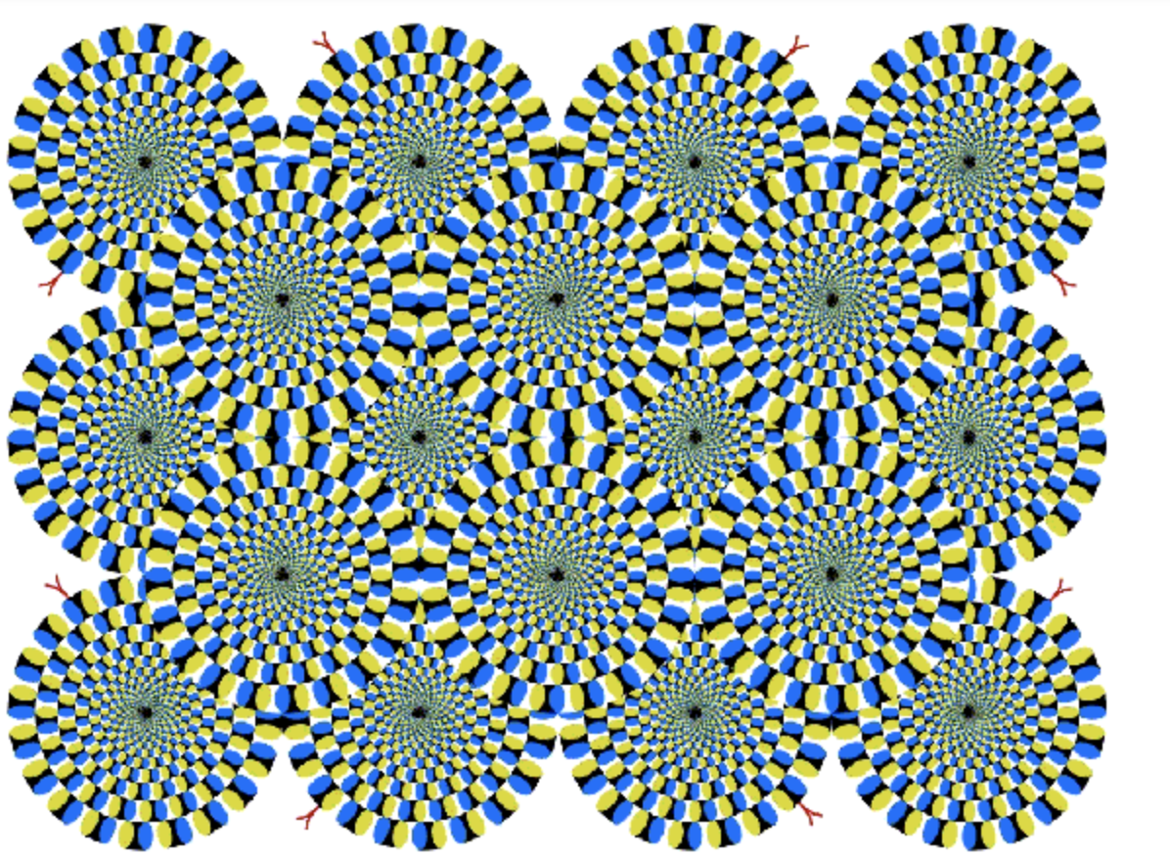

Your eyes are making these images move – they’re not animations! To test this, stare at one spot in each picture for a few seconds and everything will stop moving

Slide 16

When you look at this image, what color are the left and right hearts?
Notes:
Well, the hearts are actually the same color, it is the lines over them that are of different colors.

Slide 17

Any Questions?

Slide 18
CAN YOU SEE YOURSELF AS AN EYECARE PROFESSIONAL IN THE FUTURE?
THANK YOU!

